Slide 1

School of IT and Engineering CSCI3510 Principles of Operating System Spring 2025
CPU Scheduling Simulation
Group 3
Laman Panakhova
Aykhan Guliyev
Emil Mirzazada
Vusal Mammadov
Huseyn Sadatkhanov

Slide 2
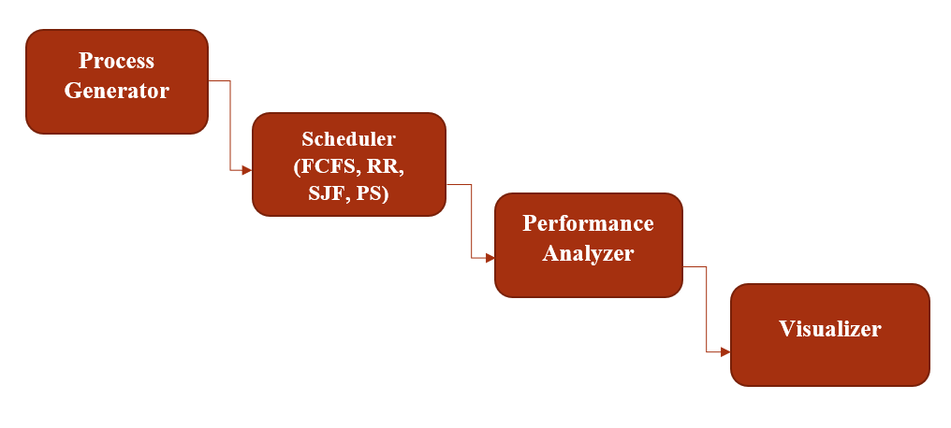
AGENDA
Introduction
Problem Statement
Project Scope And Relevance
Real-world Examples
System Architecture
Algorithms
Final Results
Diagrams
Conclusion

Slide 3
TEAM CONTRIBUTION
Team member | Contribution to the homework | Estimated %
Laman Panakhova | FCFS, Literature Review, PPT, Visuals, Uniform Distribution in Process Generation | 20%
Aykhan Guliyev | SJF, Project Proposal, PPT, Visuals, Random Distribution in Process Generation | 20%
Emil Mirzazade | RR, System Architecture, PPT, Visuals, Uniform Distribution in Process Generation | 20%
Vusal Mammadov | PS, Preliminary Results, PPT, Visuals, Random Distribution in Process Generation | 20%
Huseyn Sadatkhanov | RR, Conclusion, PPT, Visuals, Random Distribution in Process Generation | 20%

Slide 4
INTRODUCTION
Nowadays, in modern operating systems, efficient CPU scheduling is considered very important for optimizing performance, ensuring fairness among processes, and minimizing waiting time. To follow the continuing trend in this field our project focuses on implementing and comparing different CPU scheduling algorithms to analyze their efficiency and impact on process execution. The primary goal of the project is to simulate and evaluate First Come, First Served (FCFS), Round Robin (RR), Shortest Job First (SJF), and Priority Scheduling (PS) algorithms.

Slide 5
Project Scope & Real-World Examples
Understanding and analyzing these algorithms grant us with significant understandings into real-world operating systems like windows and Linux. For example, Linux kernel uses the completely fair scheduler (CFS), which incorporates principles from RR and PS. Windows OS employs a preemptive priority-based scheduling algorithm by using a multi-level feedback queue (MLFQ). Similarly, embedded systems often use FCFS or PS due to simplicity and resource constraints.
We intend to compare the performance based on average waiting time, turnaround time, and CPU utilization by implementing a simulation of the given CPU scheduling algorithms. Also, we try to visualize the sequential execution process through Gantt charts and demonstrate the impact of scheduling choices on process efficiency. Consequently, we provide a comparative analysis to determine the most efficient algorithm under various circumstances.

Slide 6
System Architecture & Implementation
Our system consisting of simulation and comparative analysis will be designed as a sectional simulation environment where processes are scheduled based on different algorithms. The main components of the implementation will include process generator - where random processes with varying burst times and priorities will be generated, scheduler - where FCFS, RR, SJF, and PS will be implemented, performance analyzer - where key metrics such as waiting time and turnaround time will be measured, and visualizer - where scheduling results will be displayed graphically.
Diving deeper into more details, algorithmic simulations will mainly focus on storing incoming processes with attributes such as process id, arrival time, burst time, start time, end time, completion time, turnaround time, and waiting time. In the end we will compute the average waiting and the average turnaround time for each algorithm separately in order to analyze the overall performance.

Slide 7
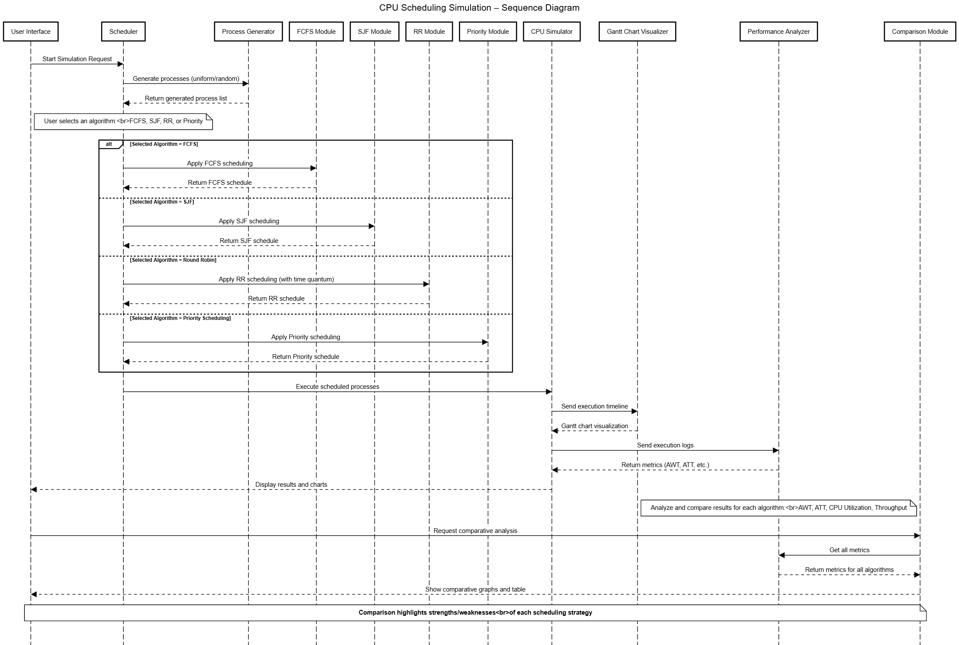
Sequence Diagram Flow of the Steps

Slide 8
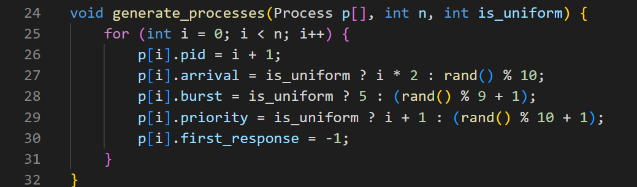
Process Generation
To simulate realistic CPU scheduling scenarios, we generated processes using both random and uniform distributions. By this we give to users 2 options to make the project more user-friendly. This approach ensures diversity and fairness in process characteristics for evaluating scheduling algorithms.

Slide 9
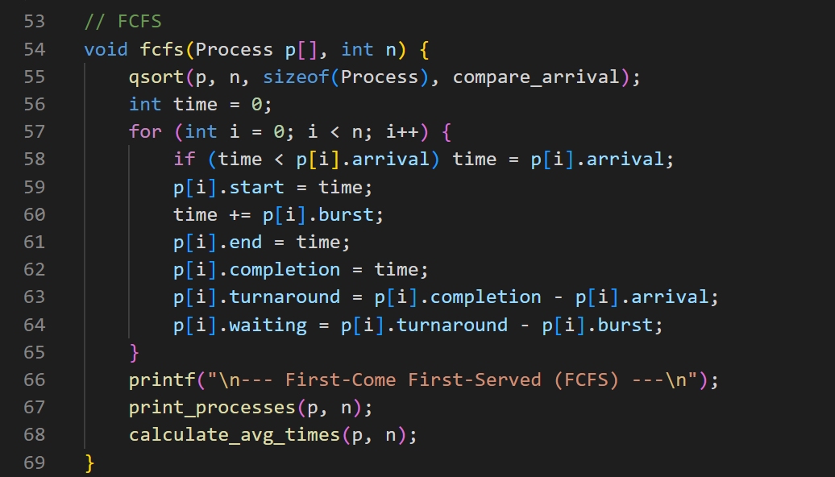
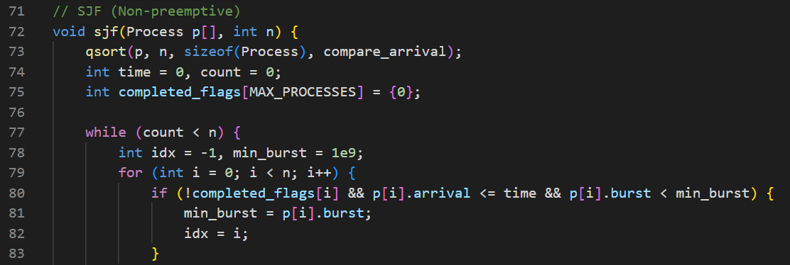
Description of Implemented Algorithms

Slide 10
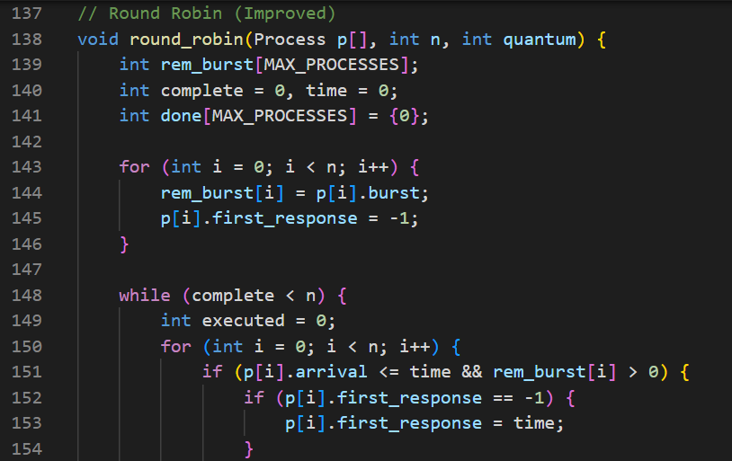
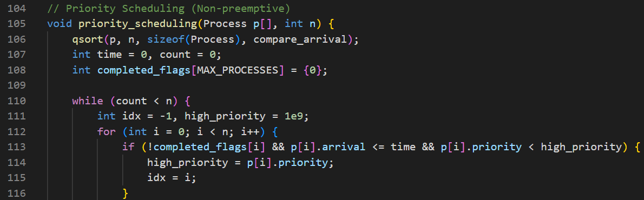
Description of Implemented Algorithms

Slide 11
Final Results & Findings
As a last step of the project, we implemented and tested the scheduling algorithms First Come First Served (FCFS), Round Robin (RR), Shortest Job First (SJF), and Priority Scheduling (PS).
Fianl results obtained:

Slide 12
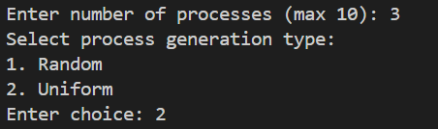
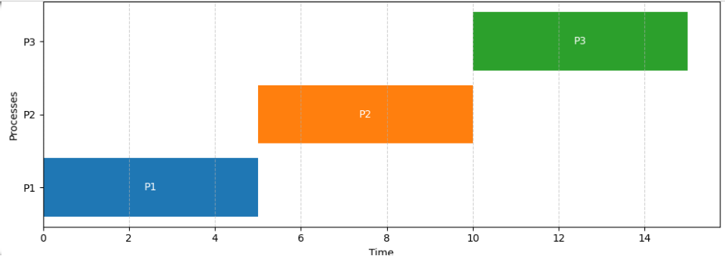
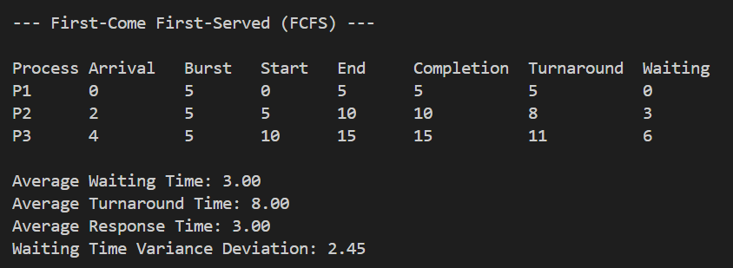
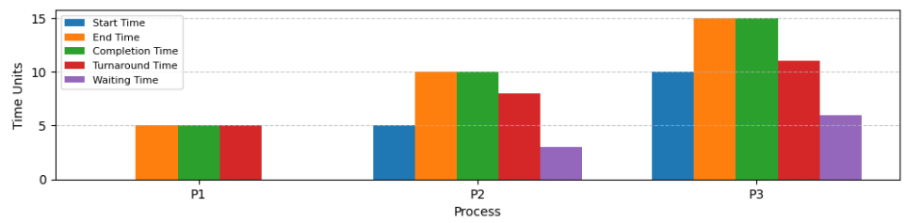
FCFS

Slide 13
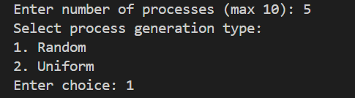
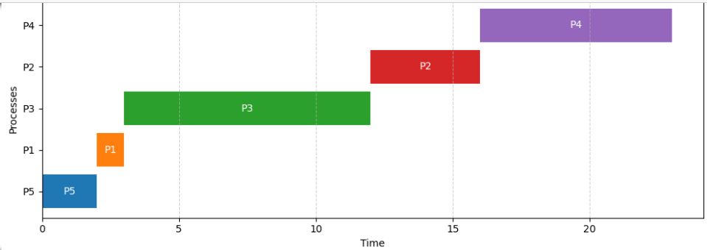
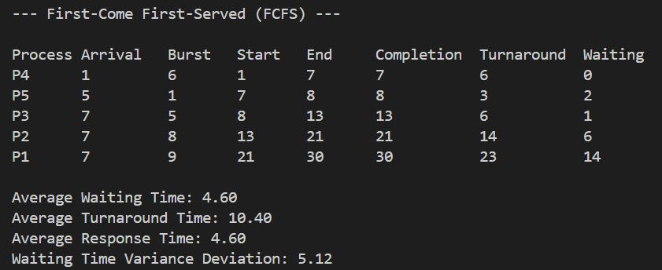
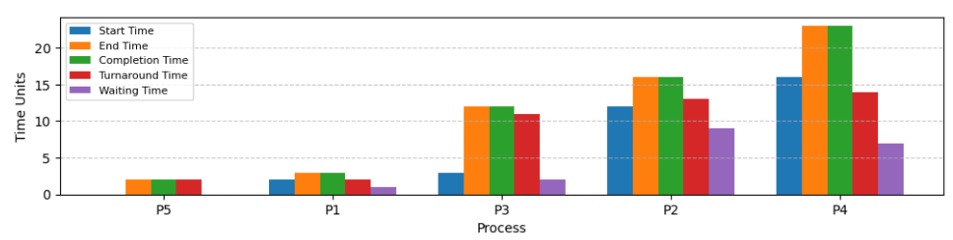
FCFS

Slide 14
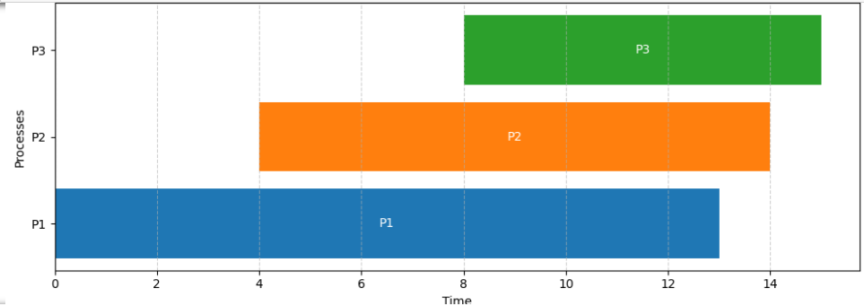
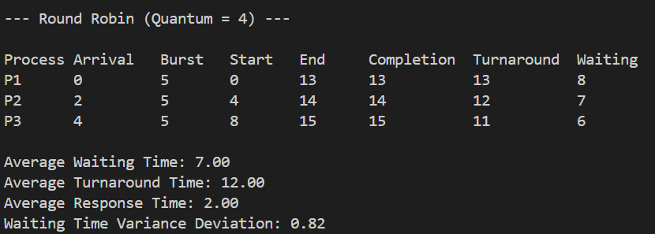
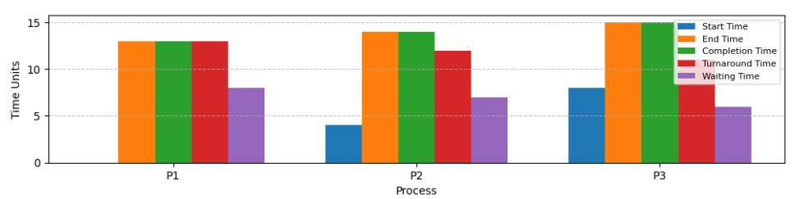
RR

Slide 15
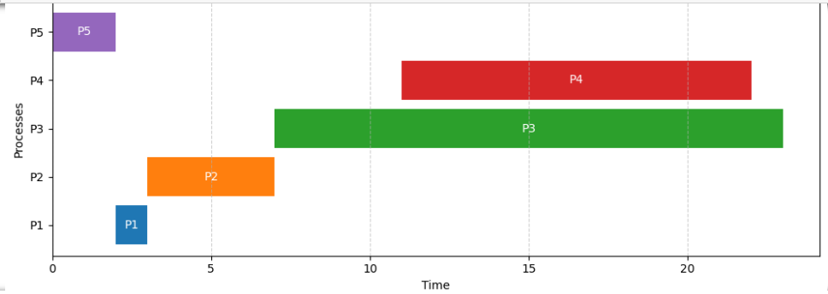
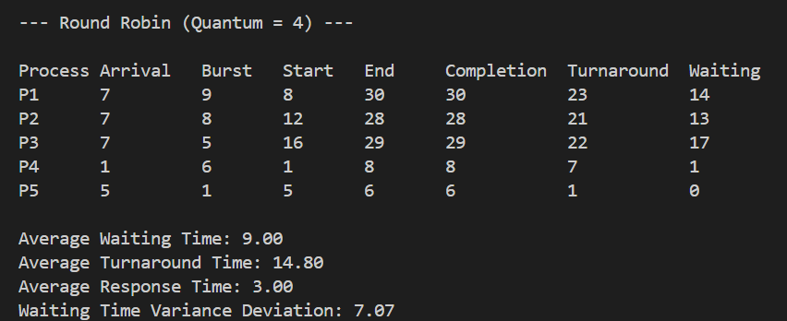
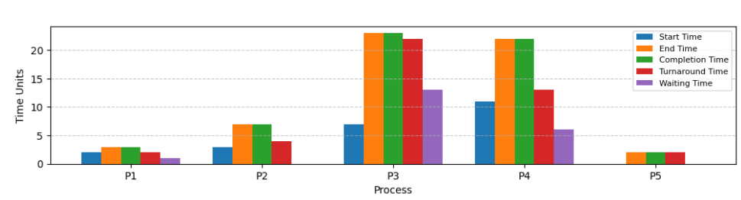
RR

Slide 16
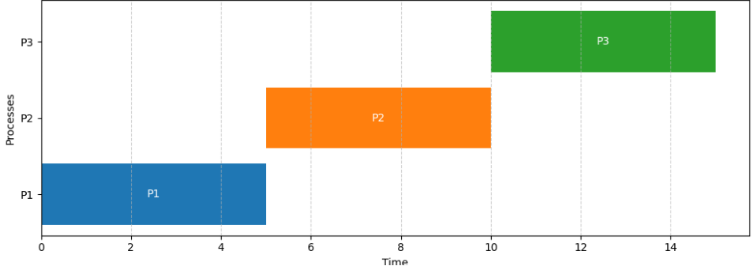
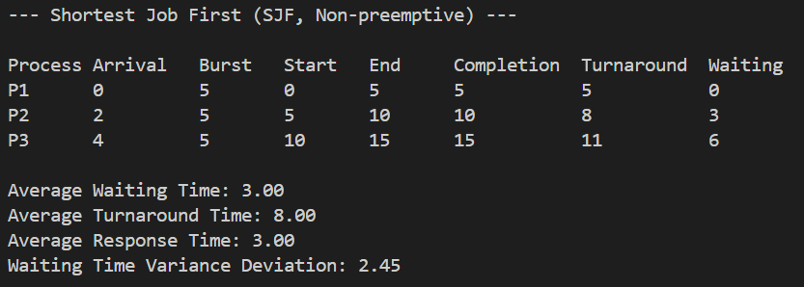
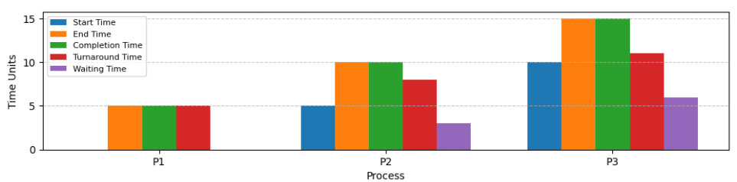
SJF

Slide 17
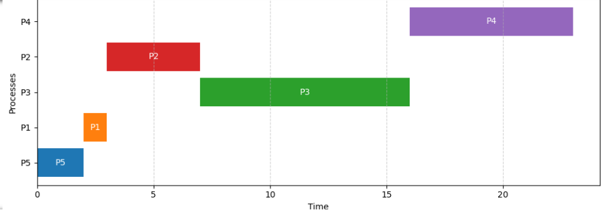
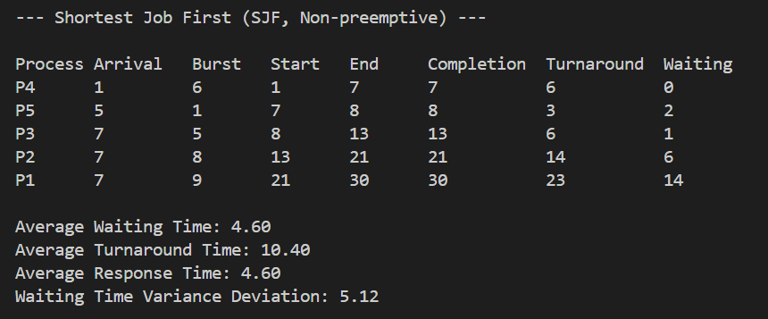
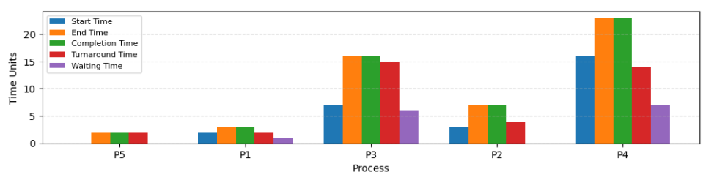
SJF

Slide 18
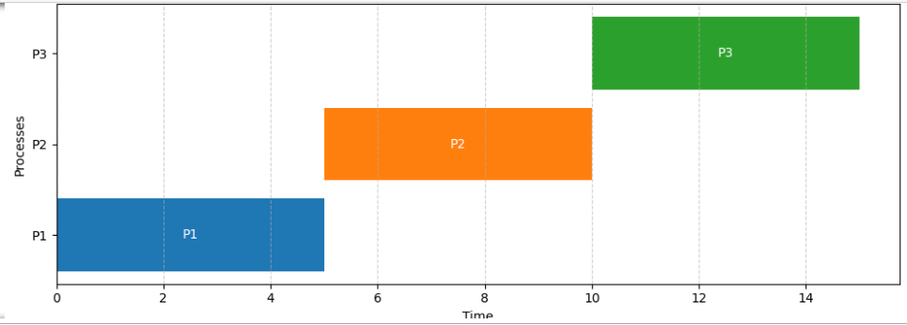
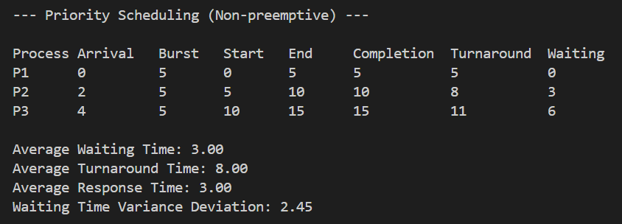
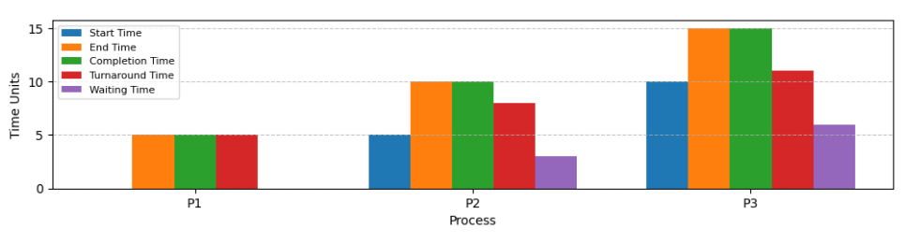
PS

Slide 19
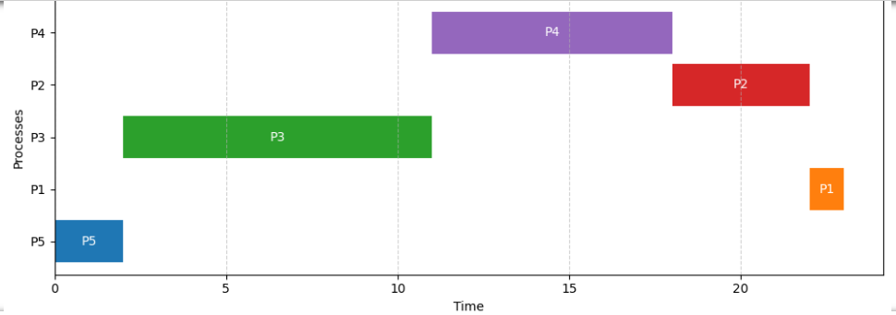
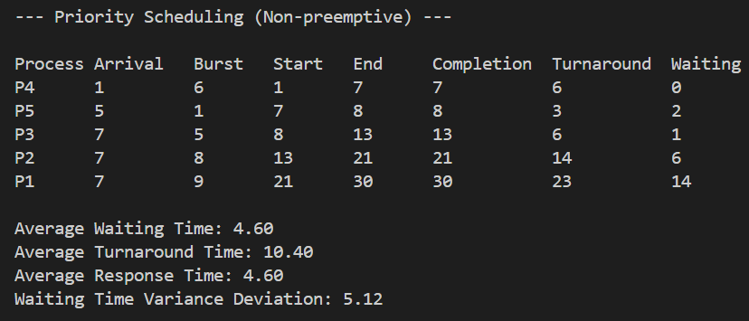
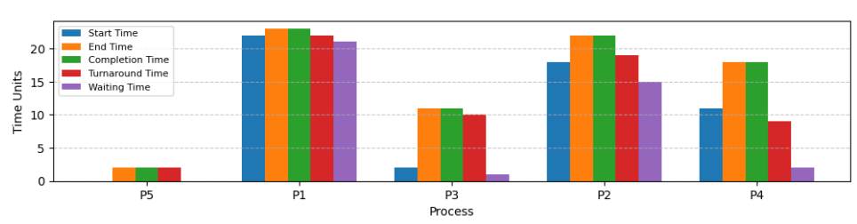
PS

Slide 20
Conclusion
Algorithm | Best For | Weaknesses
FCFS | Simple batch processing | Requires high waiting time
RR | Time-sharing systems | If quantum is too small, then too many context switches
SJF | Optimizing wait times | Happens starvation of long processes
PS | Real-time systems | Happens starvation of lower-priority processes
Our final results demonstrate the strengths and weaknesses of each CPU scheduling algorithm. It is obvious from the charts that each algorithm differs from each other for its different metrics for the use of time. By completing this project, we gained theoretical and practical insights into OS design and scheduling efficiency.

Slide 21


THANK YOU FOR YOUR ATTENTION!

